Slide 1
Project Proposal Title
Ryan Leveille
Dustin Vasquez

Slide 2
Introduction (RL)
We are interested in the factors that effect GDP per employee (productivity by employee) in both emerging and developing countries.
We both have an interest in economics. We thought this would be a fun dataset to work on.

Slide 3
Introduction (RL)
We want to find meaningful factors that effect employee productivity (GDP per employee) across countries.

Slide 4









Slide 5
Hypothesis and Questions
We believe access to electricity will positively effect employee productivity.
We believe internet usage will positively effect employee productivity.
We believe communication usage will positively effect employee productivity.
What are the effects of different industry trends on employee productivity?
What are the effects of employment type trends on employee productivity?

Slide 6

Data
https://databank.worldbank.org/source/jobs
20 different countries (10 developing, 10 developed)
15 year time frame (2000 – 2014)
300 Cases total

Slide 7
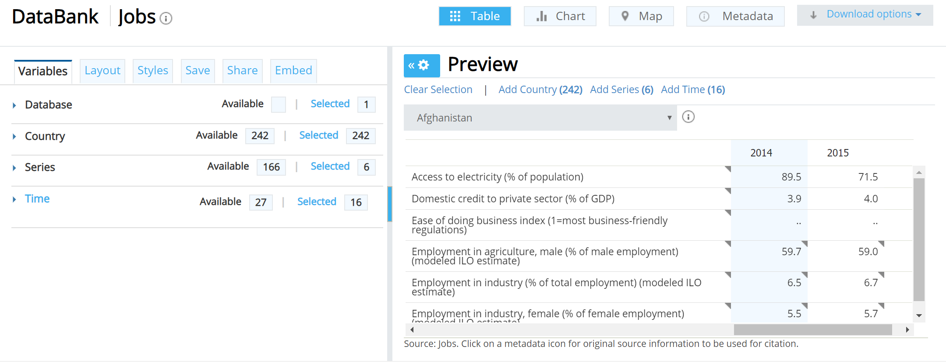
Select the correct data
Downloading the Data

Slide 8
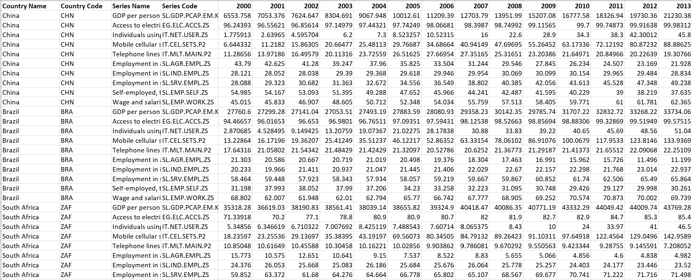
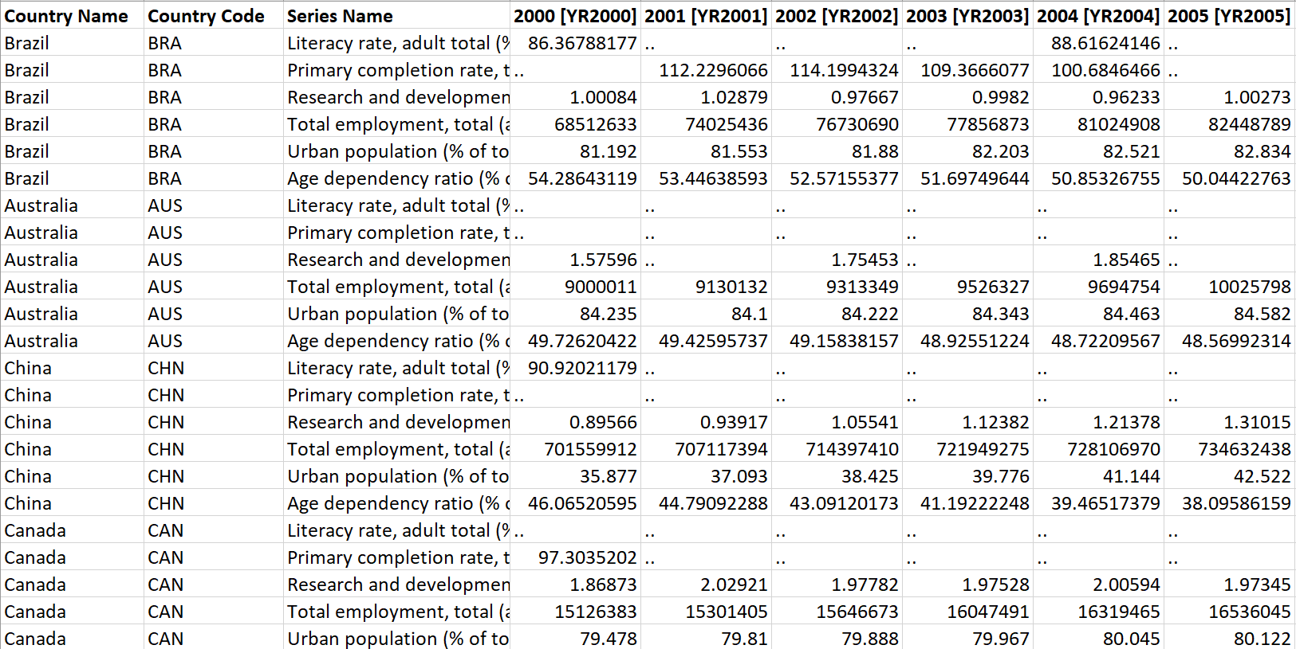



Format Headings
Merge
Datasets
Fill N/A Values

Slide 9
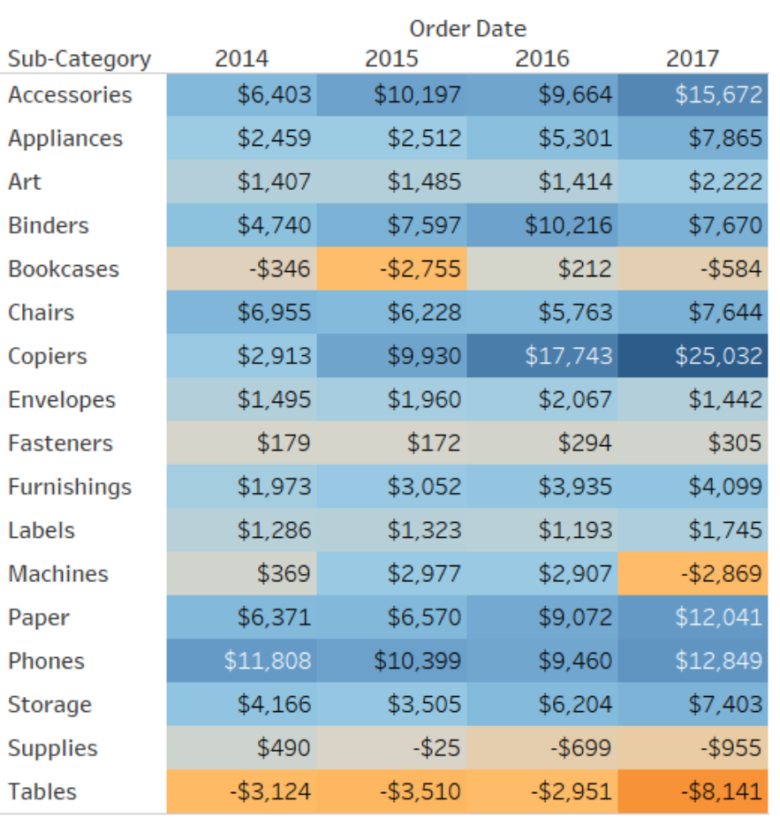
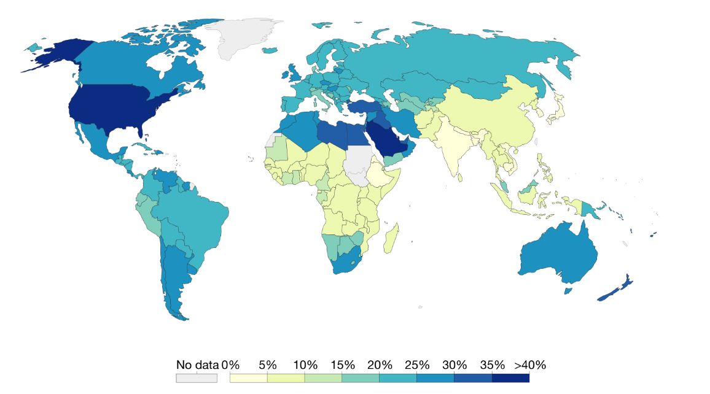
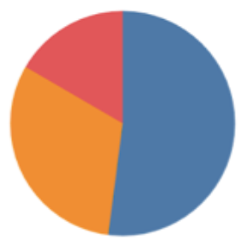
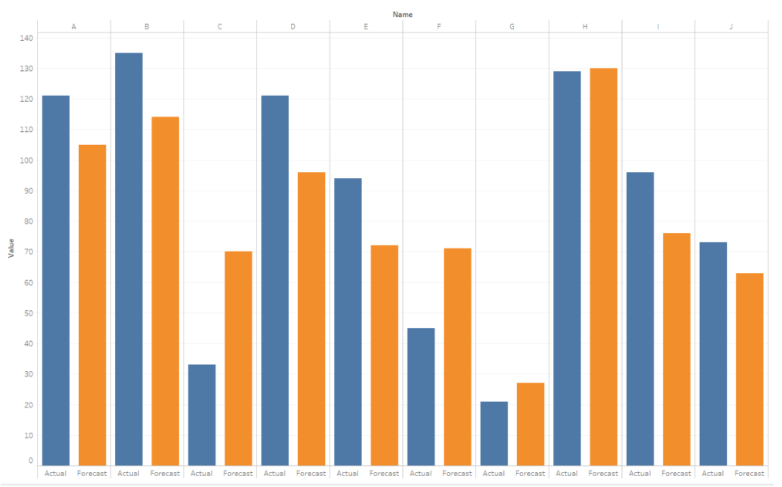
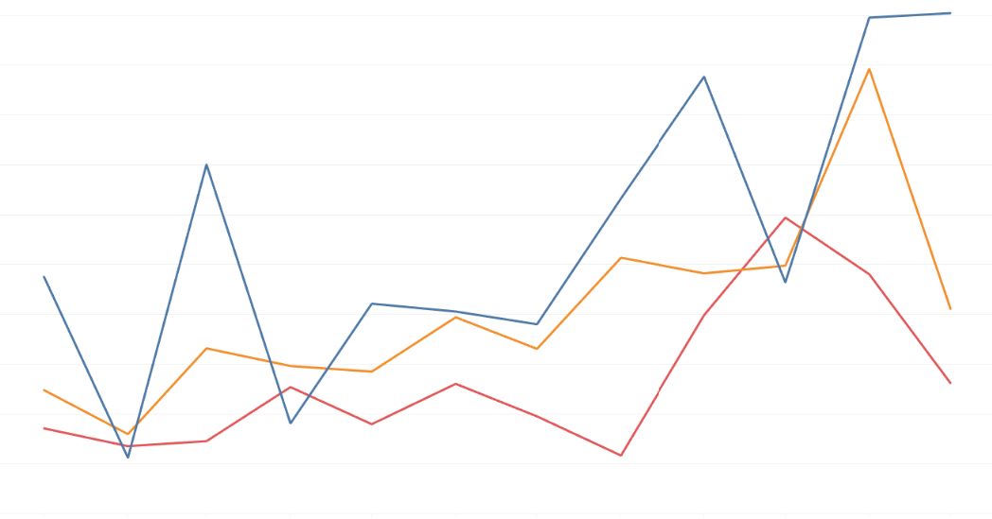
Visual Analysis

Slide 10
Tentative Schedule
Task | Date (Start)
Download Data | February 21, 2020
Prepare Data | March 5, 2020
Explore and Learn Data | March 19, 2020
Visual Analysis | April 9, 2020
Final Project Due | April 23, 2020

Slide 11
Thank You!

